Slide 1



Mini Project -Design Review
MATRUSRI ENGINEERING COLLEGE
Department of CSE
Portal to know about national and international scholarships
Project Batch Number :B-21
Project Guide : Mrs. B J Praveena, Asst professor
Student Names Roll No
1.Kavali Srikanth 1608-20-733-103
2. Srikanth b 1608-20-733-113

Slide 2
Content Page
MATRUSRI ENGINEERING COLLEGE
Department of CSE
Abstract
Methodology
UML diagrams
Modules/Architecture Diagram

Slide 3
Abstract
MATRUSRI ENGINEERING COLLEGE
Department of CSE
The scholarship website is a user-friendly platform that connects students with a wide range of scholarship opportunities. Through a simple registration process, students can create an account and access personalized features. By providing their information, students can discover scholarships tailored to their eligibility and interests.
The website offers three types of scholarships: TS-Scholarships, National Scholarships, and International Scholarships. With a search function, students can easily find scholarships based on specific criteria.
The student dashboard presents eligible scholarships and provides direct application links. This centralized platform aims to empower students in their pursuit of higher education by facilitating access to relevant scholarships.

Slide 4
MATRUSRI ENGINEERING COLLEGE
Department of CSE
Methodology
The e-Procurement project follows a systematic approach, starting with gathering requirements, defining functionalities, and establishing a scope.
The system design phase focuses on architecture and user interface, while front-end development uses HTML, CSS, and JavaScript for user-friendly interfaces.
Back-end development uses PHP for server-side functionality, and integration ensures a unified system.
Testing, deployment, and maintenance ensure smooth operation, with XAMPP server environment setup and database connectivity.

Slide 5
MATRUSRI ENGINEERING COLLEGE
Department of CSE
UML Diagrams
UML diagrams like class, use case, activity and sequence diagrams. Each diagram indicates the some sort of information in different forms about the project.
Class Diagram
Scholarship: This class represents a scholarship available on the website. It contains attributes such as scholarship, title, description, link, and type. It may also have relationships with other classes, such as a one-to-many relationship with the Scholarship Application class.
Student: This class represents a student who uses the website. It includes attributes like student, name, email, and password. It may have associations with other classes, such as a one-to-many relationship with the Scholarship Application class.
1.5

Slide 6
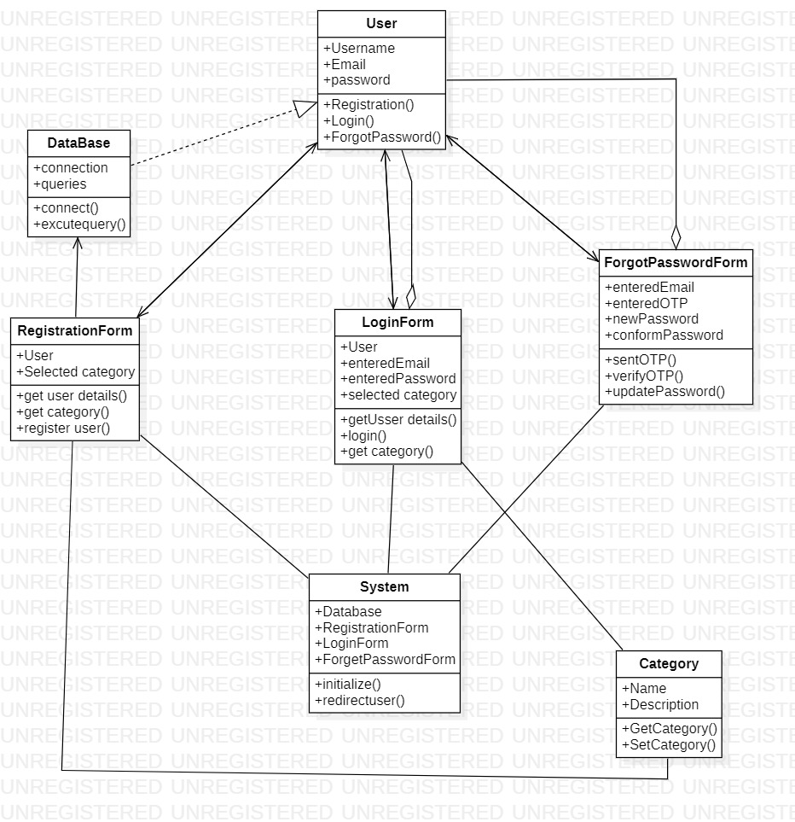
MATRUSRI ENGINEERING COLLEGE
Department of CSE
UML Diagrams(Class)
1.6
1.6

Slide 7
MATRUSRI ENGINEERING COLLEGE
Department of CSE
MATRUSRI ENGINEERING COLLEGE
Department of CSE
Proposed System
UML Diagrams
Use Case Diagram
Use case represented the different tasks performed by the student in website. Here student can do the following using login and Registers view scholarships ,search required scholarship, if scholarship found then apply for it and log out the website.
1.7

Slide 8
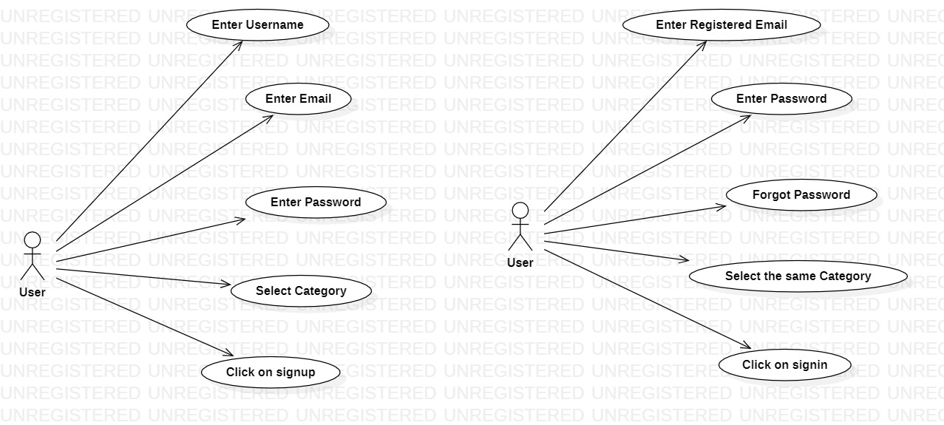
MATRUSRI ENGINEERING COLLEGE
Department of CSE
UML Diagrams(Use Case)
1.8

Slide 9
MATRUSRI ENGINEERING COLLEGE
Department of CSE
UML Diagrams
Activity Diagram
Activity diagram of the user represents the process flow of the user between login and logout. It involves one condition that checks the login credentials of the user if it doesn’t matches with the details in the database it will show prompt of Invalid username or password.
1.9

Slide 10
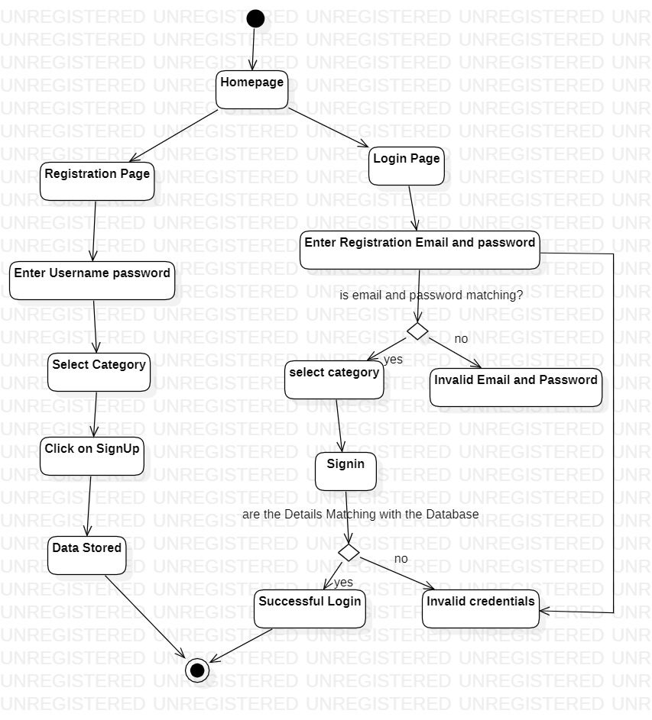
MATRUSRI ENGINEERING COLLEGE
Department of CSE
UML Diagrams(Activity)
1.10

Slide 11
MATRUSRI ENGINEERING COLLEGE
Department of CSE
UML Diagrams
Sequence Diagram
The sequence diagram illustrates the chronological sequence of interactions and messages exchanged between different components and objects within system. It showcases the flow of actions during user registration, login, and password recovery processes. The diagram depicts the steps involved in each process, starting with the user's interaction with the system.
1.11
1.11

Slide 12
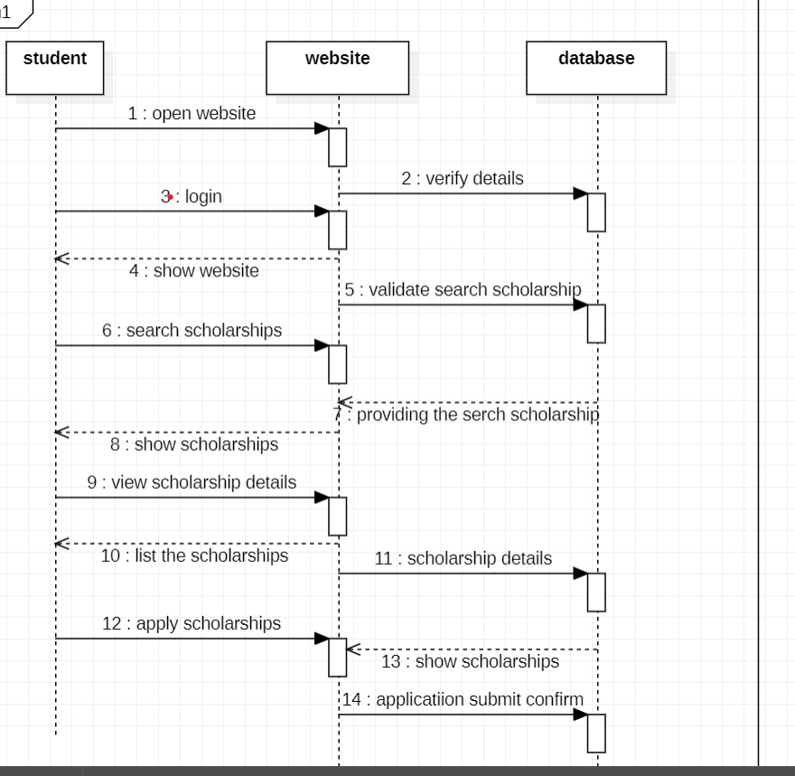
MATRUSRI ENGINEERING COLLEGE
Department of CSE
Sequence Diagram
1.12
1.12
1.12

Slide 13
MATRUSRI ENGINEERING COLLEGE
Department of CSE
Modules
Scholarship Listing Module:
This module focuses on displaying the available scholarships to users. It includes functionalities for listing scholarships, providing details such as title, description, eligibility criteria, and application links. It also enables users to search and filter scholarships based on specific criteria.
Student Dashboard Module:
This module provides a personalized dashboard for students upon logging in. It displays relevant information such as recommended scholarships, eligibility notifications, and the status of their submitted applications. It may also include features for managing personal details, saved scholarships, and application history.
1.13
1.13
1.13

Slide 14
MATRUSRI ENGINEERING COLLEGE
Department of CSE
Modules
User Management Module:
This module handles user registration, login, and authentication. It allows students, scholarship providers, and administrators to create accounts, manage their profiles, and access the appropriate features based on their roles.
Search and Filtering Module:
his module provides a robust search functionality, allowing users to search for scholarships based on specific criteria such as scholarship type, location, field of study, or eligibility requirements. It enhances the user experience by helping them find scholarships that match their preferences.
1.14
1.14
1.14

Slide 15
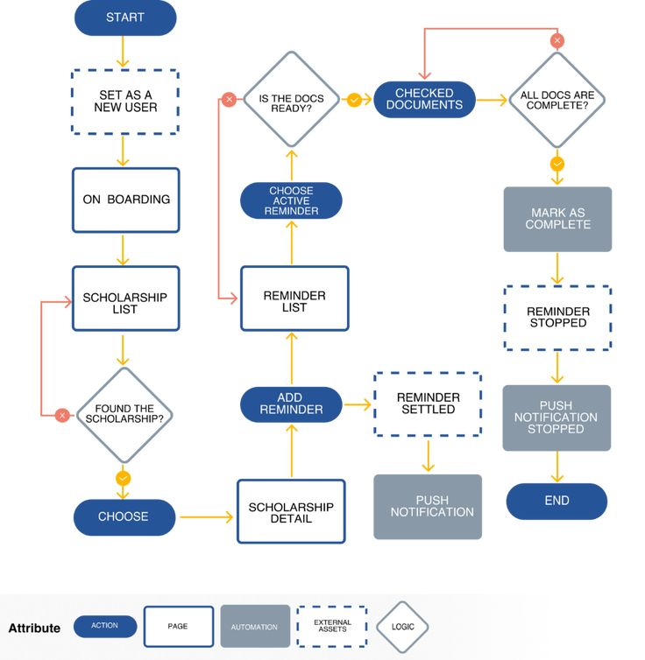
MATRUSRI ENGINEERING COLLEGE
Department of CSE
Architecture Diagram
1.15
1.15
1.15

